Slide 1

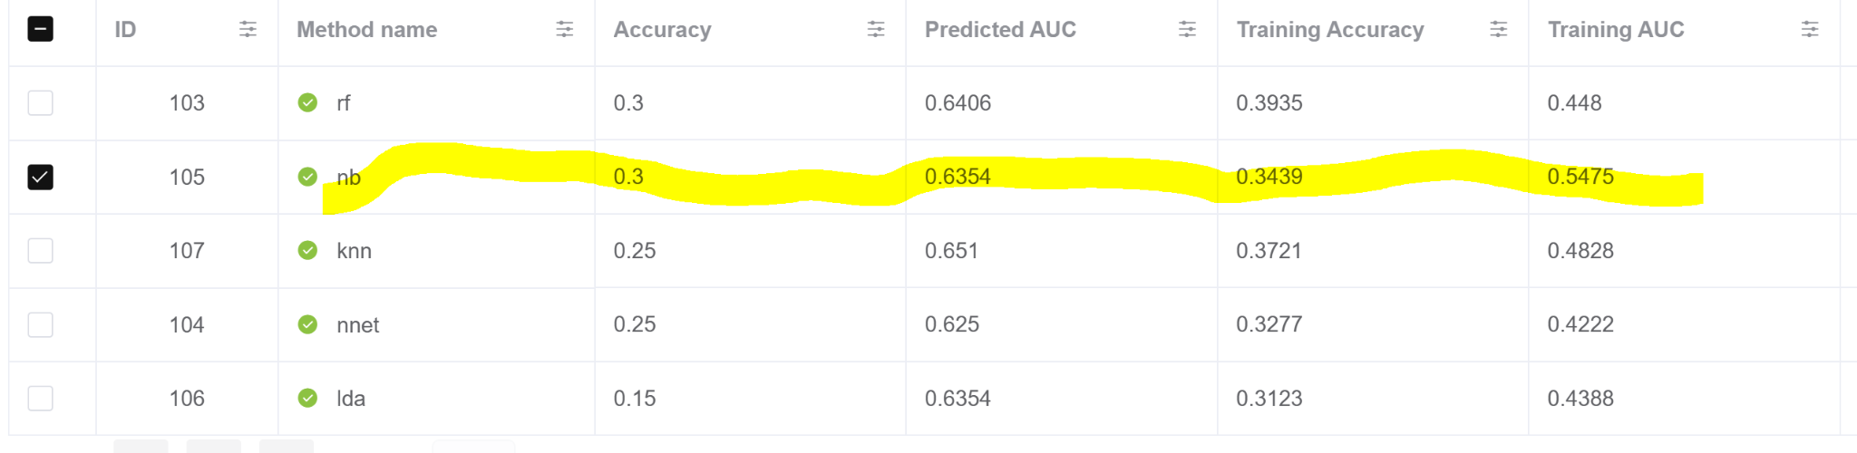
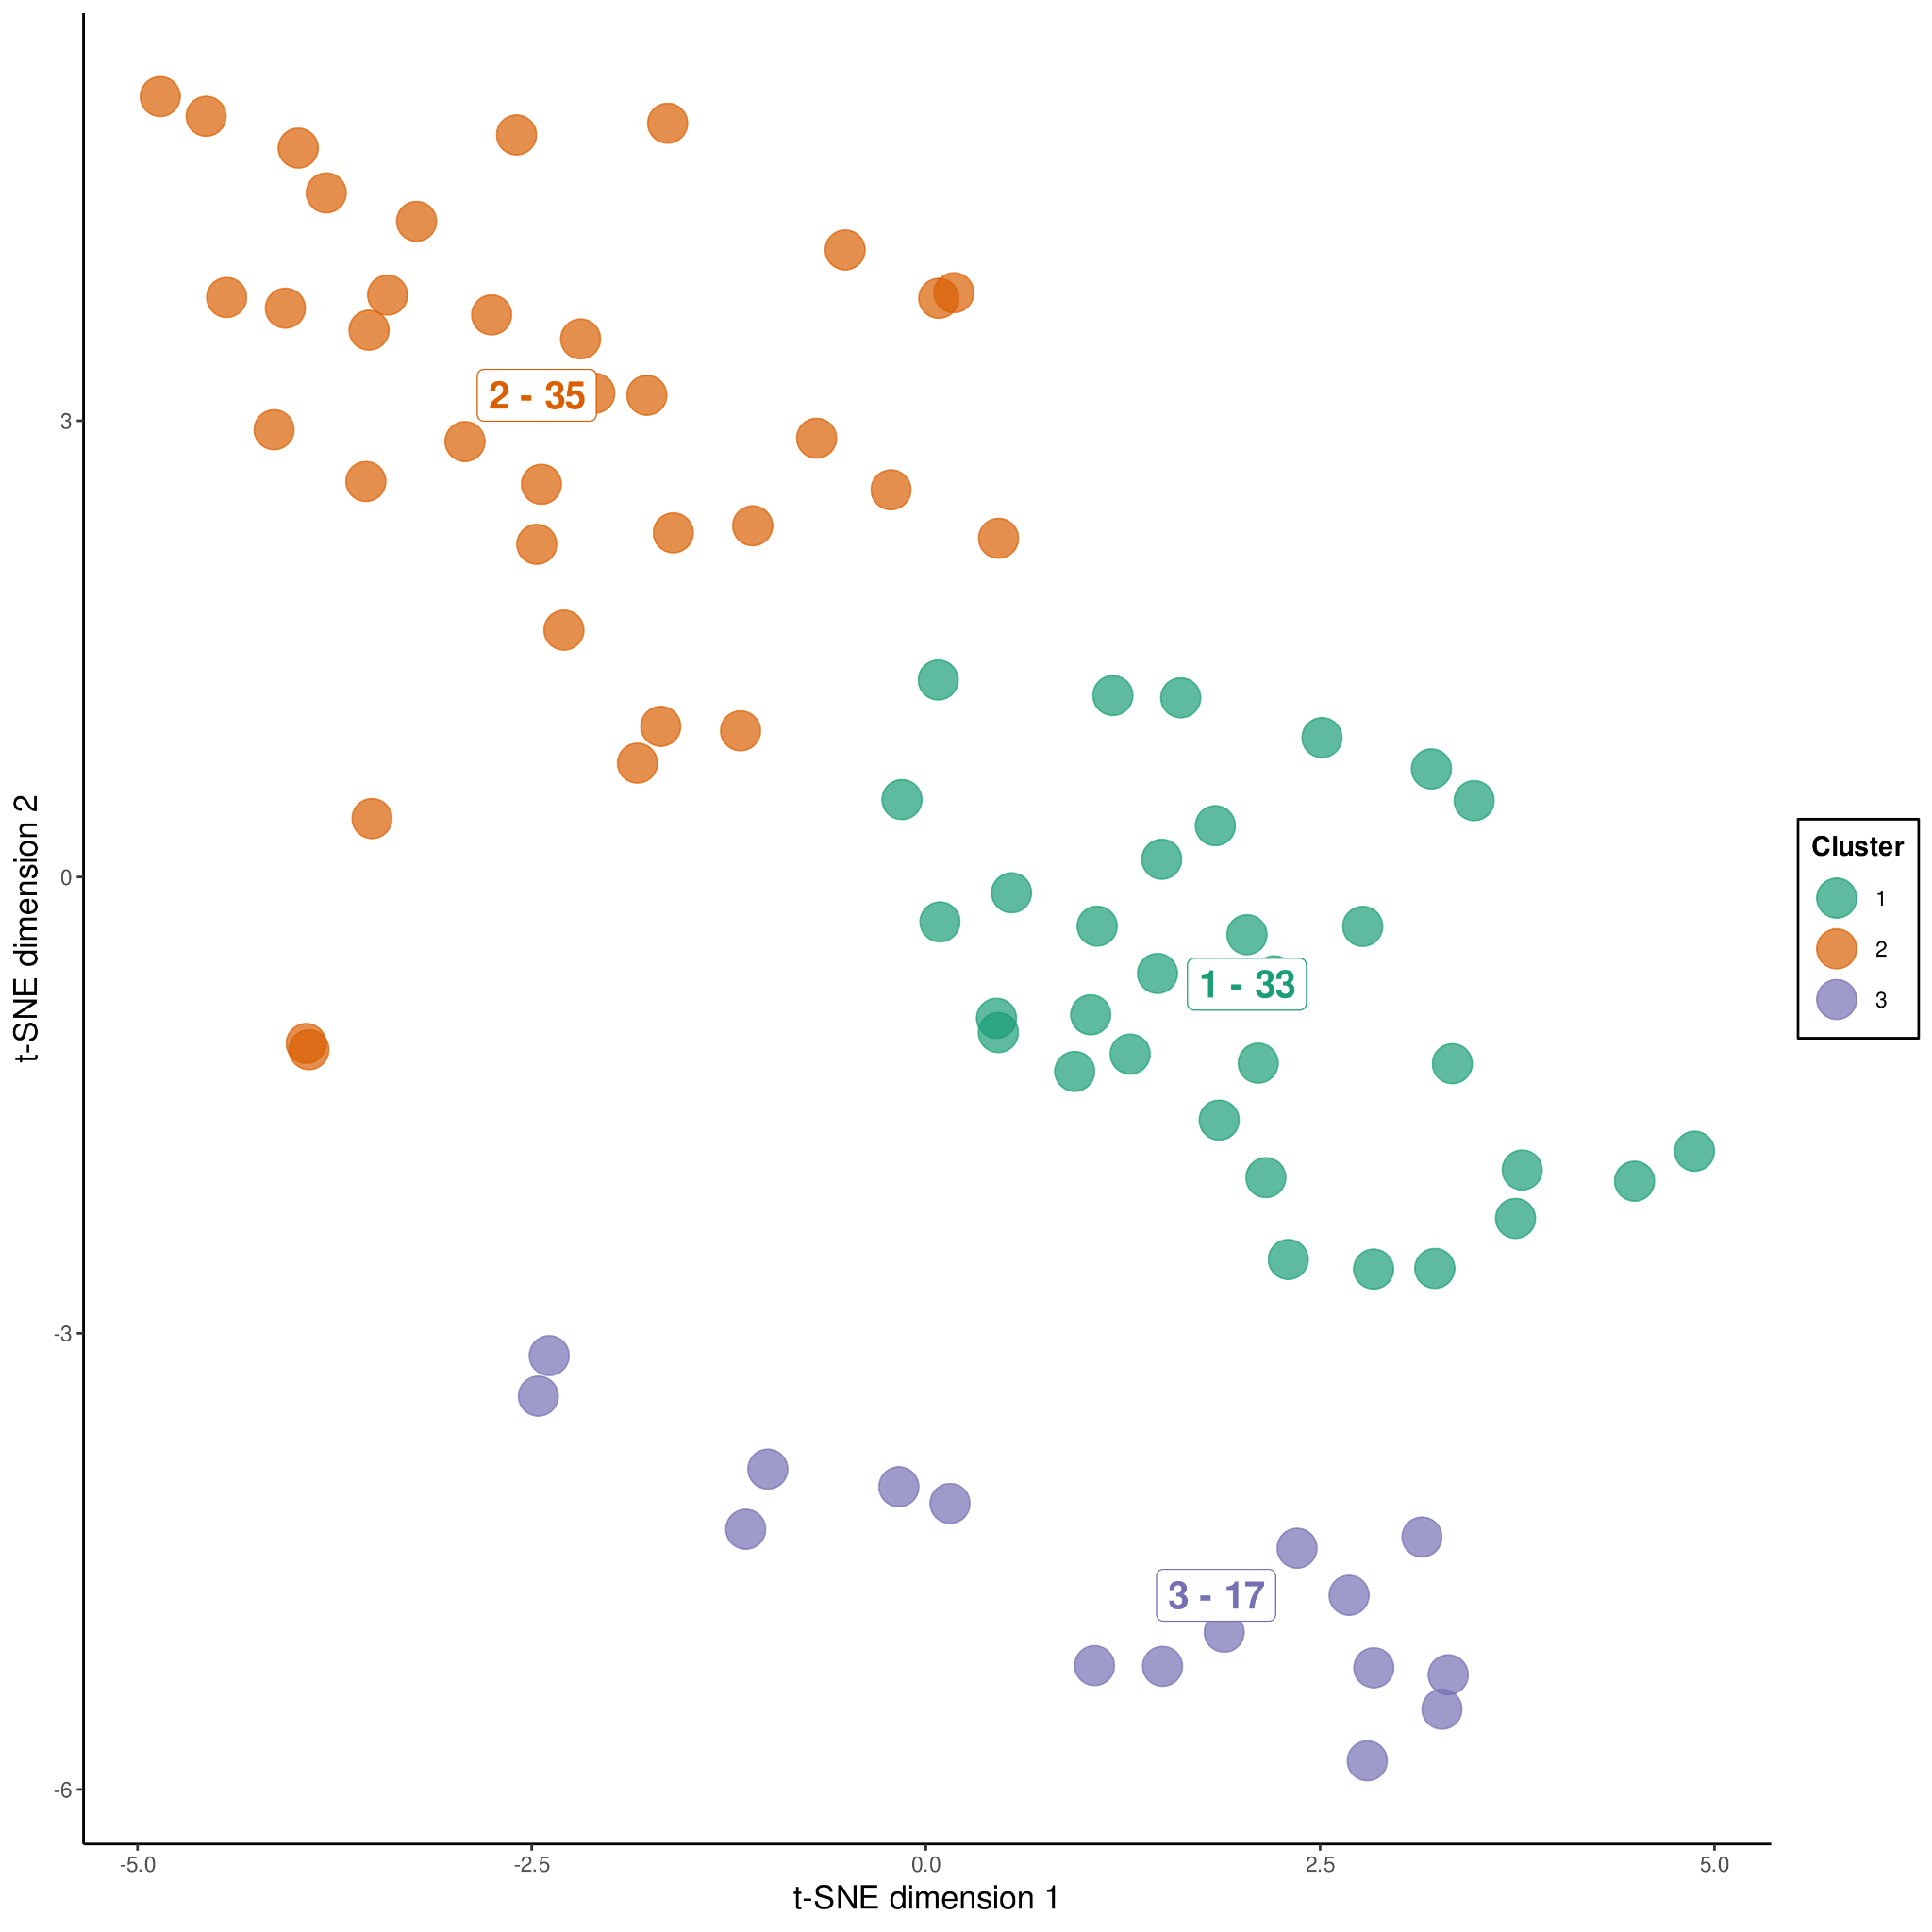
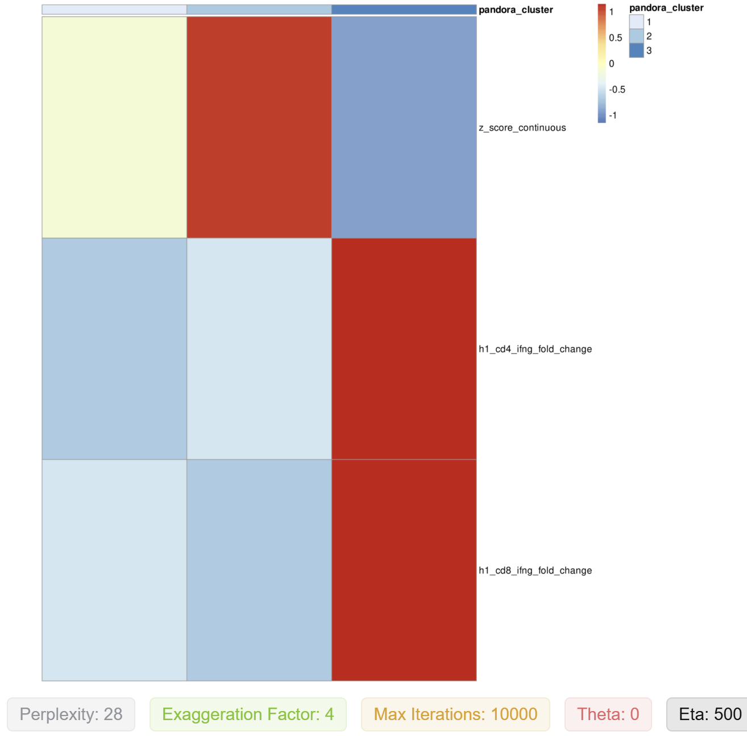
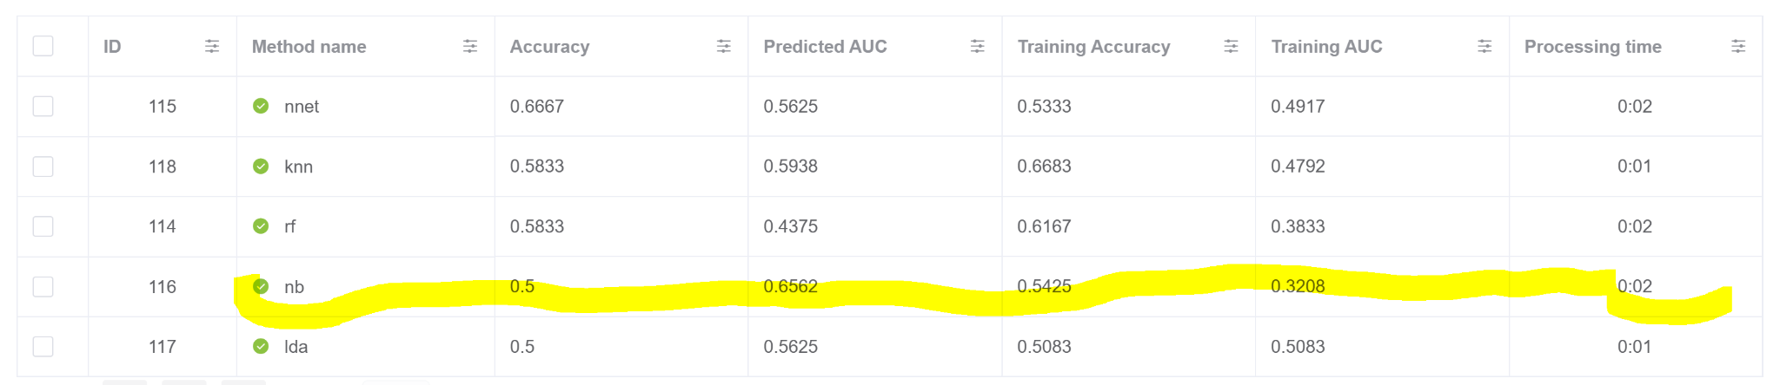
http://localhost:3010
Group 6: Team Noble
Research question: Can baseline presence of different features be used to predict fold change efficacy in patients with varying nutrition?
Step 2: Run predictive models to establish best model and features (85 samples [65|20])
Step 1: tSNE for nutrition Z Scores, CD4 & CD8 fold changes
Step 3: Reduce to 2 classes to increase variance (52 samples [40|12])
Notes:
Target variables: 2 clusters (2 and 3) = nutrition is high but bad fold change

